Slide 1
The Proposal Process. Part 2
LCGFT Training

Slide 2
Scope
  Accessing the proposal form
    PDF proposal form
    ClassWeb Plus proposal form
  Filling out the proposal form
  Submitting a proposal for review

Slide 3
LCGFT Manual Instruction Sheets
J 107 MARC Authority Records for LC Genre/Form Terms
J 140 Preparation of Genre/Form Term Proposals
J 180 Form of the Authorized Genre/Form Term
J 186 Broader Term References
J 188 Related Term References
J 190 “Used for” References
J 195 Scope Note

Slide 4
1. Cataloging scenario
2. Check ClassWeb Plus
Is there already a proposal for my term?
4. Proposal logistics
How do I make a proposal?
How do I fill out a proposal form? How do I submit my proposal?
Does the resource need a new term?
3. Authority research
Proposal process workflow overview

Slide 5
Proposal Logistics: Access Proposal Form
LCGFT Proposal Form PDF
ClassWeb Plus Proposal System

Slide 6
Warrant: Resources that Justify the Proposal
Work Cat: Comprehensive dictionary of abbreviations used everywhere, 2023
Additional source: Dictionary of abbreviations (being citations of those terms used in the professions, sport and trade), 1913
Additional source: Acronyms dictionary, 1960
Not found in source: Oxford English dictionary online, viewed July 7, 2025
LCGFT Manual instruction sheets

Slide 7
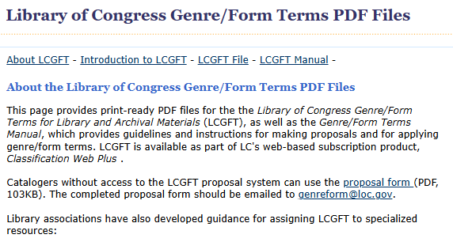
https://www.loc.gov/aba/publications/FreeLCGFT/freelcgft.html
Image: The LCGFT Manual website

Slide 8
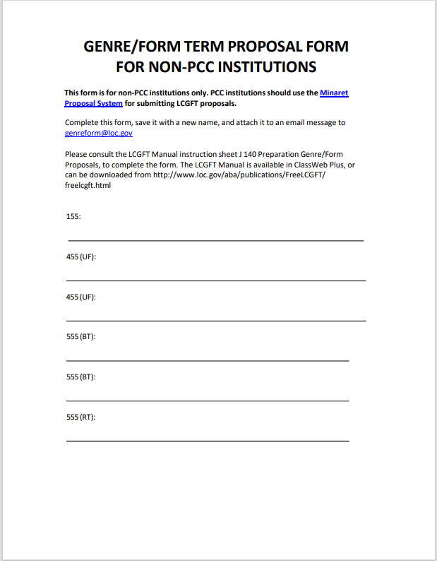
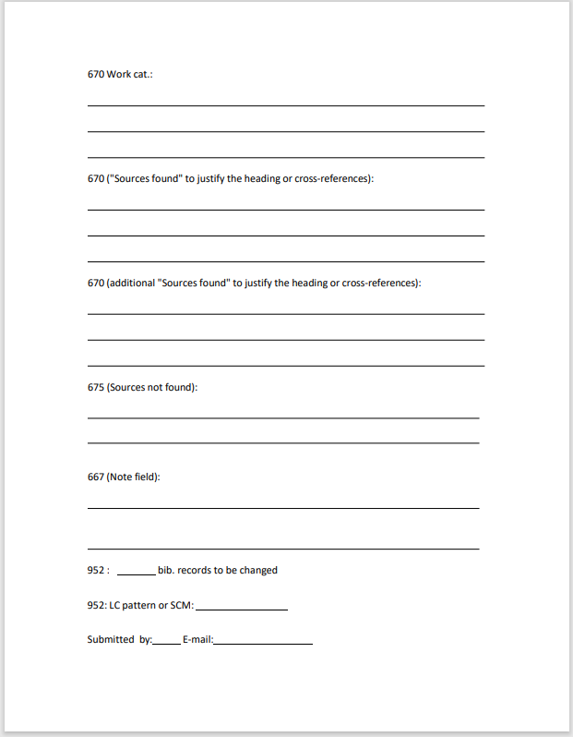
Image: LCGFT PDF proposal form

Slide 9
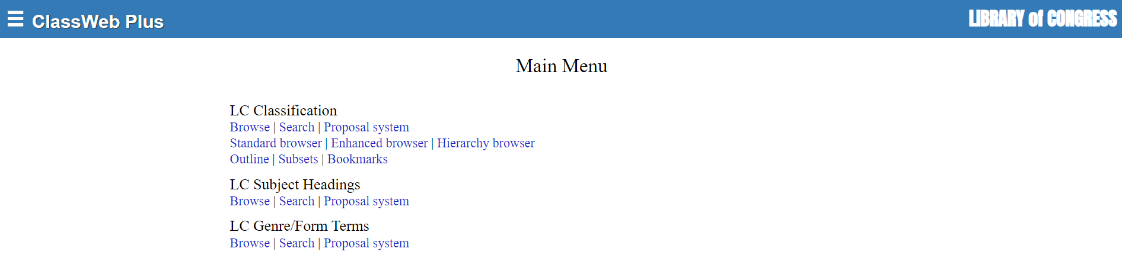
https://classweb.org/Proposal/
Image: ClassWeb Plus with the LC Genre/Form Terms link to the proposal system circled in orange

Slide 10
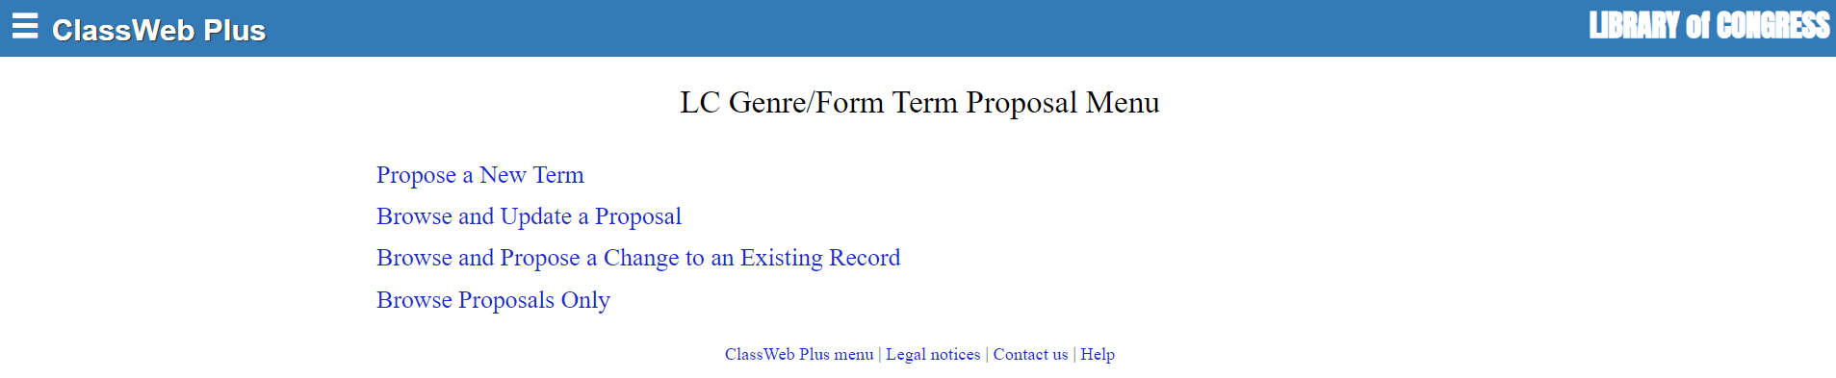
Propose a New Term
Image: ClassWeb Plus LCGFT proposal menu

Slide 11
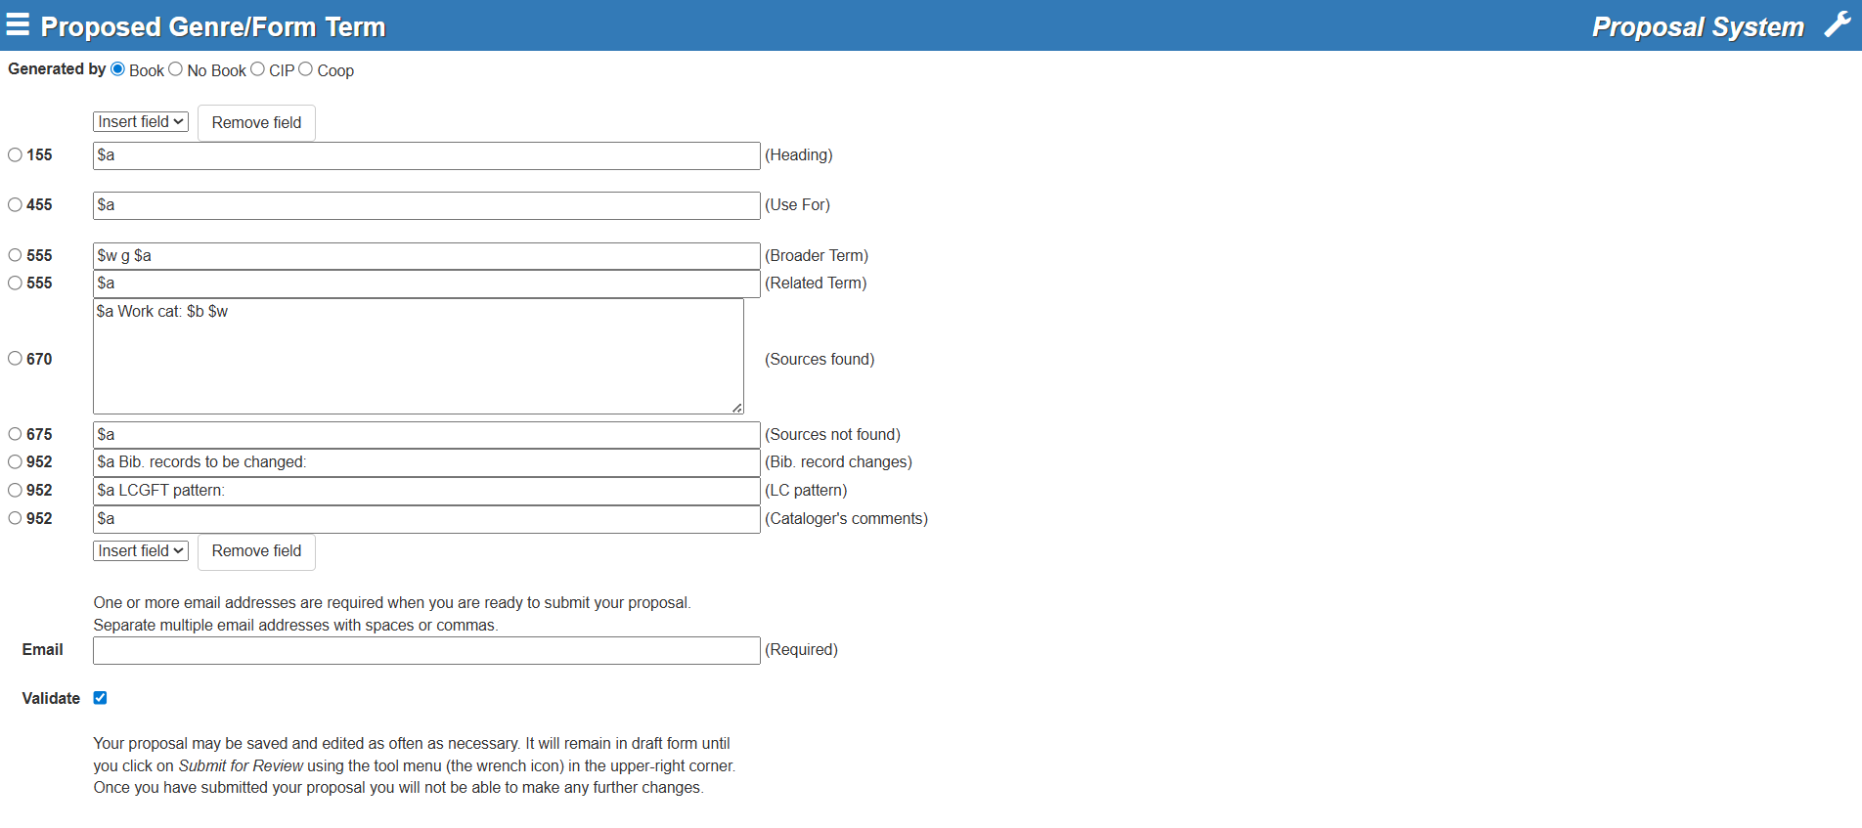
The Proposal form
Image: ClasssWeb Plus proposal form

Slide 12
J 107 MARC Authority Records for LC Genre/Form Terms
Image: ClassWeb Plus proposal form

Slide 13
J 140 Section 3: Generated by
Image: ClassWeb Plus proposal form

Slide 14
J 140 Section 4: Authorized term
Image: ClassWeb Plus proposal form

Slide 15
J 140 Section 6: Citation of Sources
Image: ClassWeb Plus proposal form

Slide 16
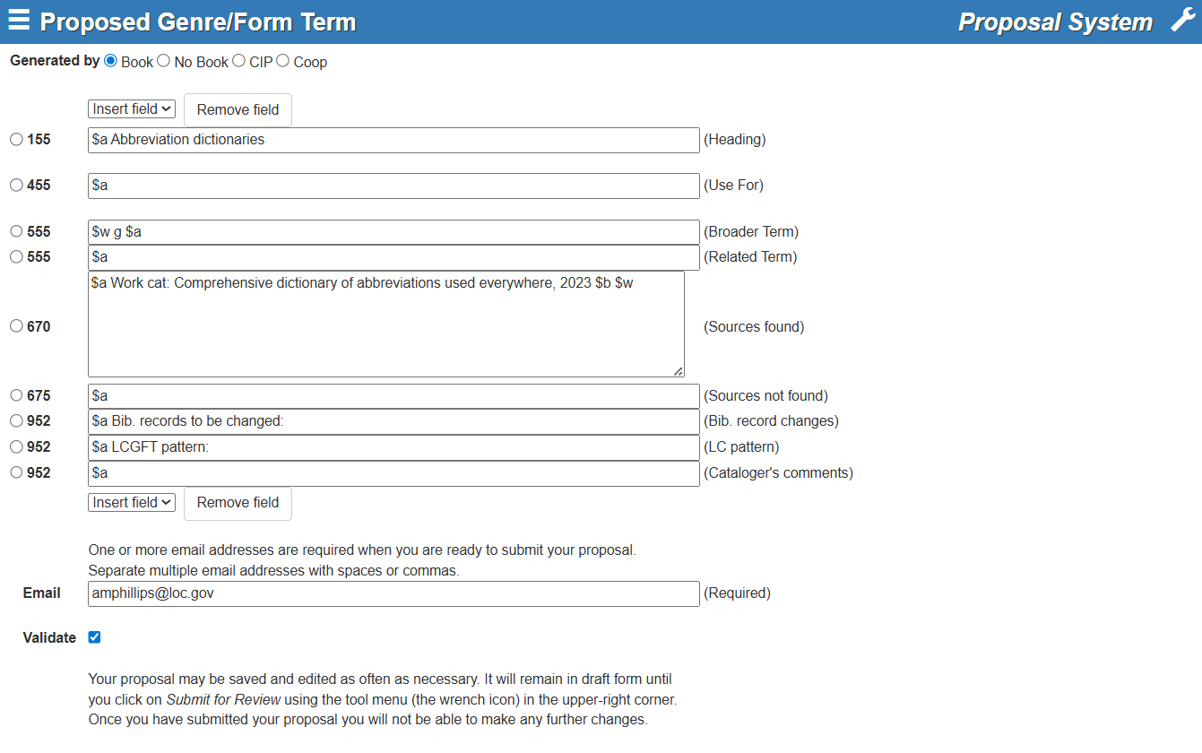
J 140 Section 6a:Resource cataloged
$b - Information found in the source
$w – LCCN
Image: ClassWeb Plus proposal form

Slide 17
J 140 Section 6b:Other sources in which the term was found
Image: ClassWeb Plus proposal form

Slide 18
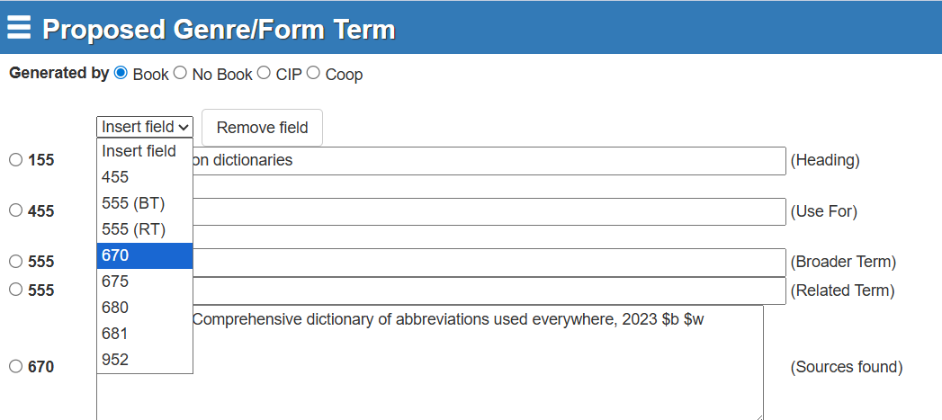
Insert field drop down
Image: ClassWeb Plus proposal form showing the Insert field drop-down

Slide 19
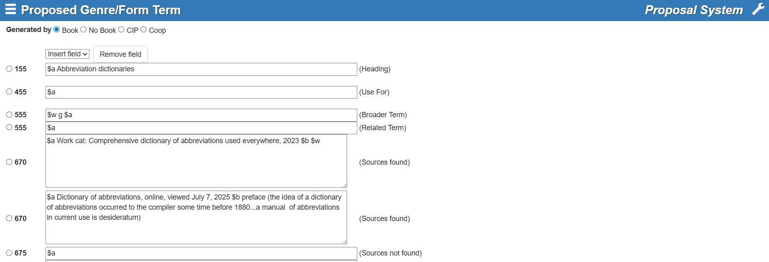
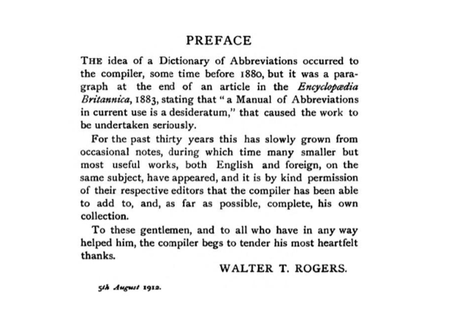

J 140 Section 6b:Example
Image: Preface
Image: ClassWeb Plus proposal form

Slide 20
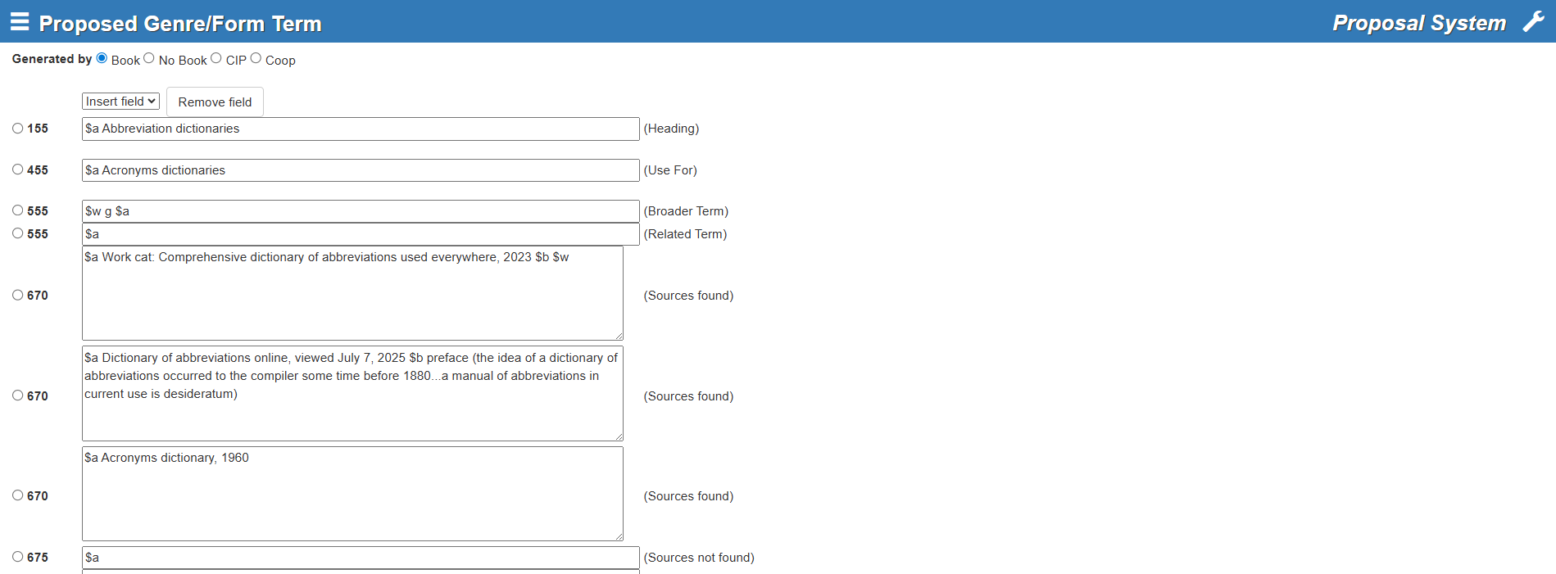
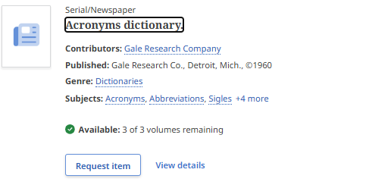
J 140 Section 5b: Used for references (UFs)
Image: Catalog record for Acronyms dictionary
Image: ClassWeb Plus proposal form

Slide 21
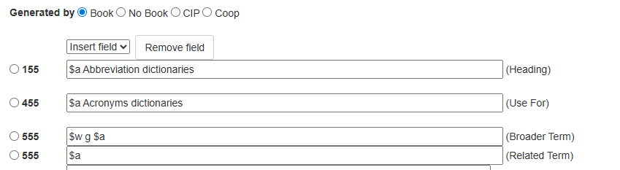
J 140 Section 5c: Broader Terms and Related Terms
Image: ClassWeb Plus proposal form
“Follow the principles in J 186 and J 188 for making broader term and related term references.”

Slide 22
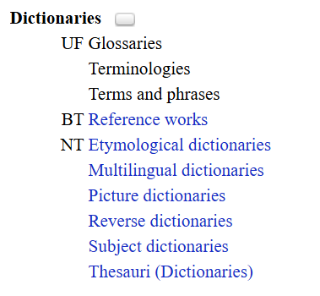
J 186 Section 2: Make at least one BT
Image: Display of established term Dictionaries in ClassWeb Plus

Slide 23
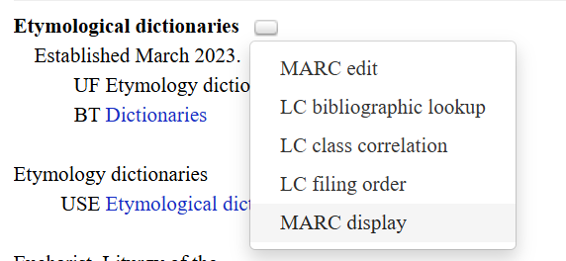
LCGFT pattern: Etymological dictionaries
Image: Display of established term Etymological dictionaries in ClassWeb Plus; list of 5 actions, MARC display selected

Slide 24
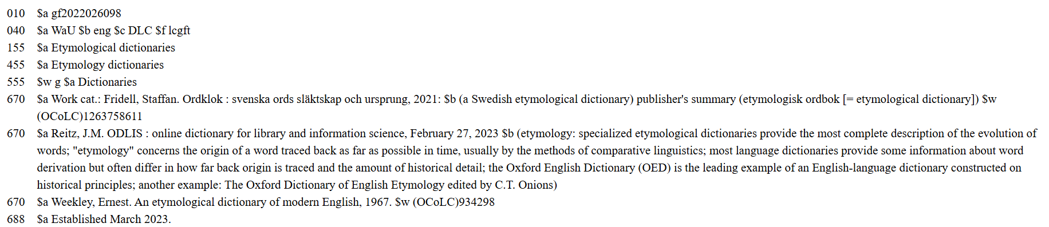
LCGFT pattern: Etymological dictionaries
Image: MARC record for Etymological dictionaries

Slide 25
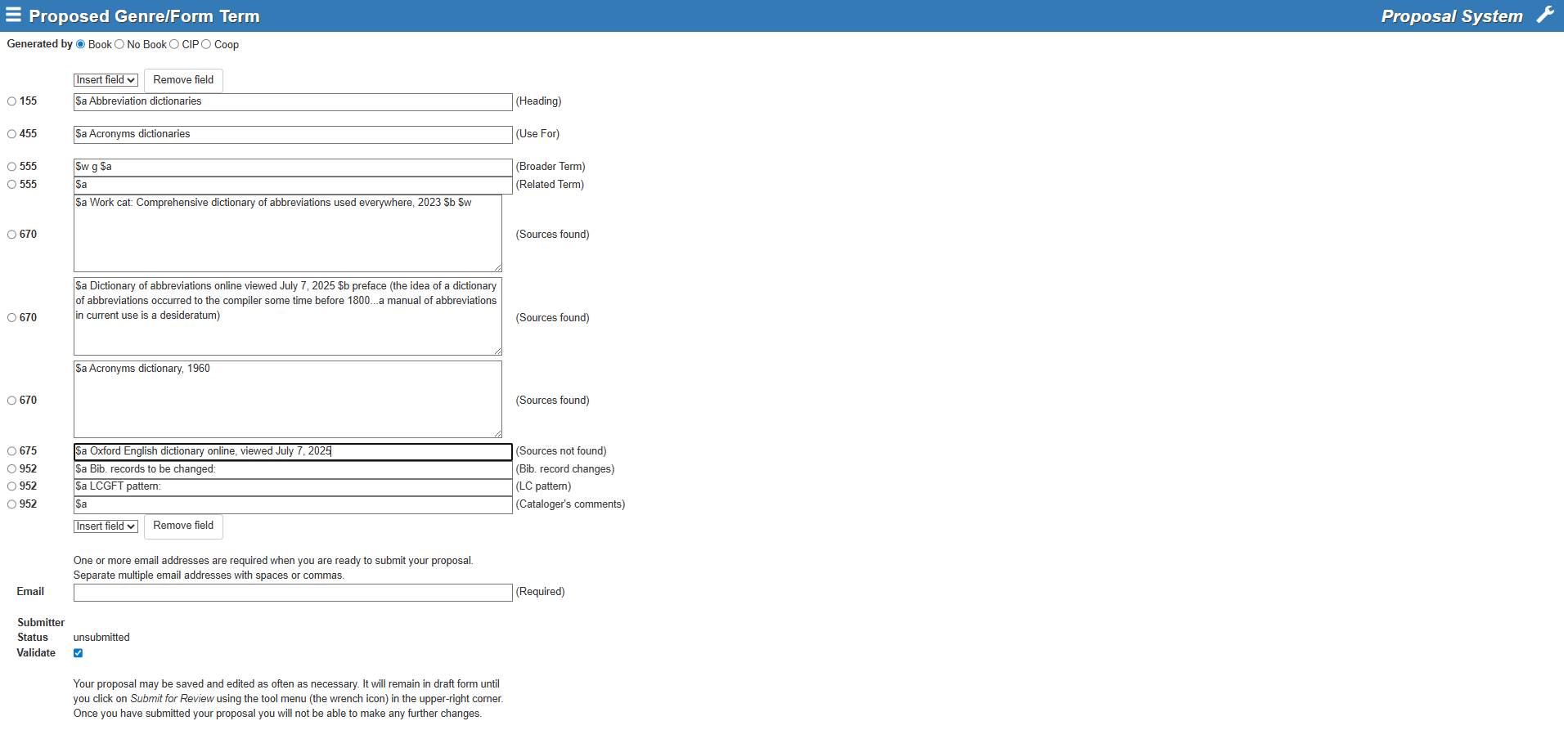
675 field is not required
Image: ClassWeb Plus proposal form

Slide 26
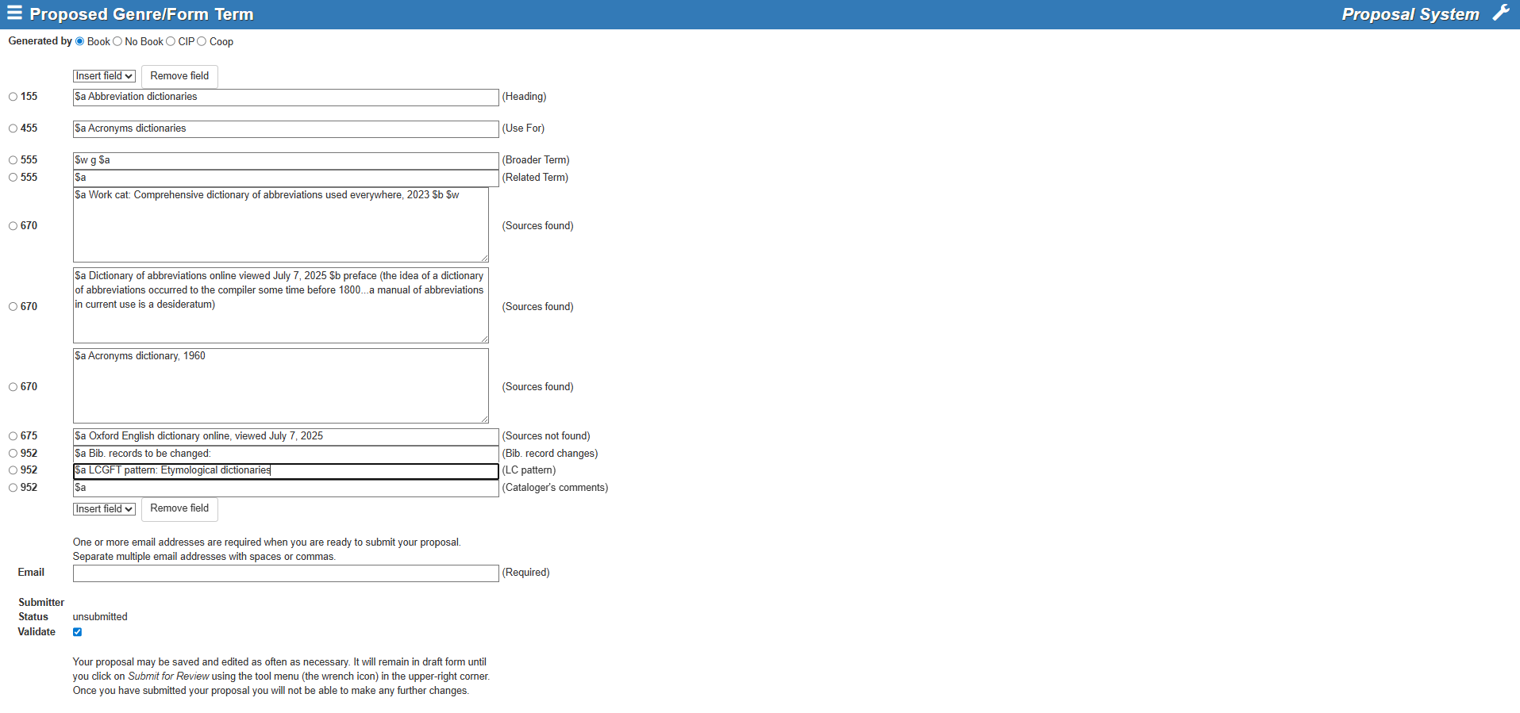
Image: ClassWeb Plus proposal form

Slide 27
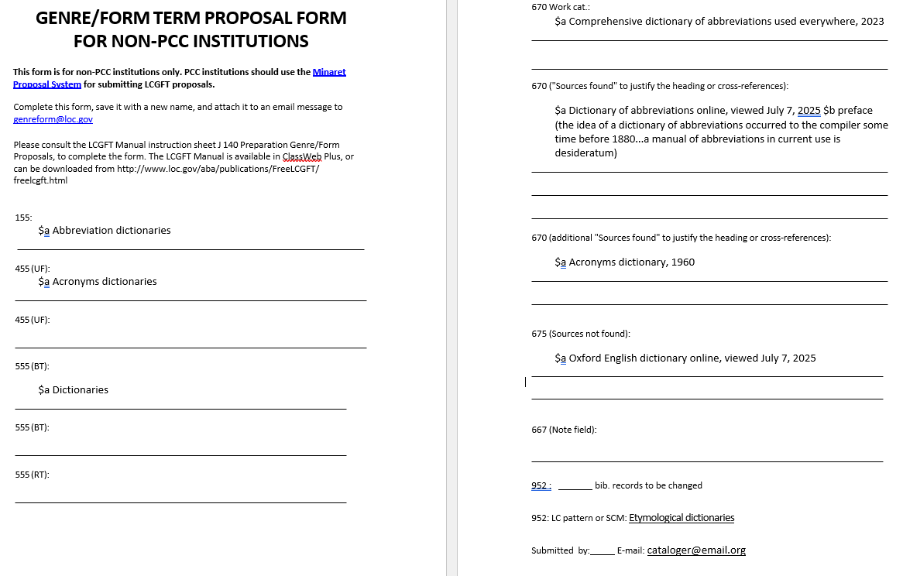
Image: Completed proposal form PDF

Slide 28
Image: ClassWeb Plus proposal form

Slide 29
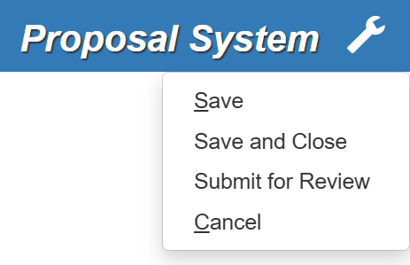
Wrench icon
Image: List of 4 actions: Save, Save and Close, Submit for Review, Cancel

Slide 30
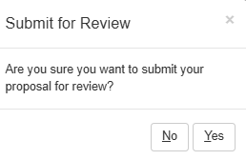
Submit for Review pop-up box
Image: Submit for Review pop-up box asks “Are you sure you want to submit your proposal for review?” The No and Yes buttons appear under the question.

Slide 31
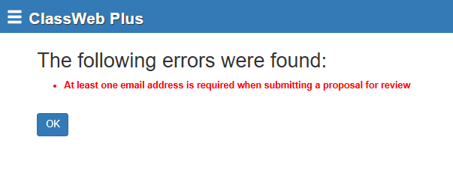
Error message
Image: Error message says “At least one email address is required when submitting a proposal for review

Slide 32
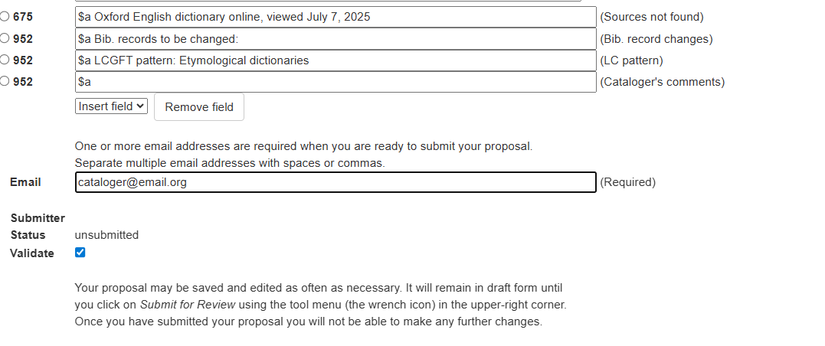
Image: ClassWeb Plus completed proposal form

Slide 33
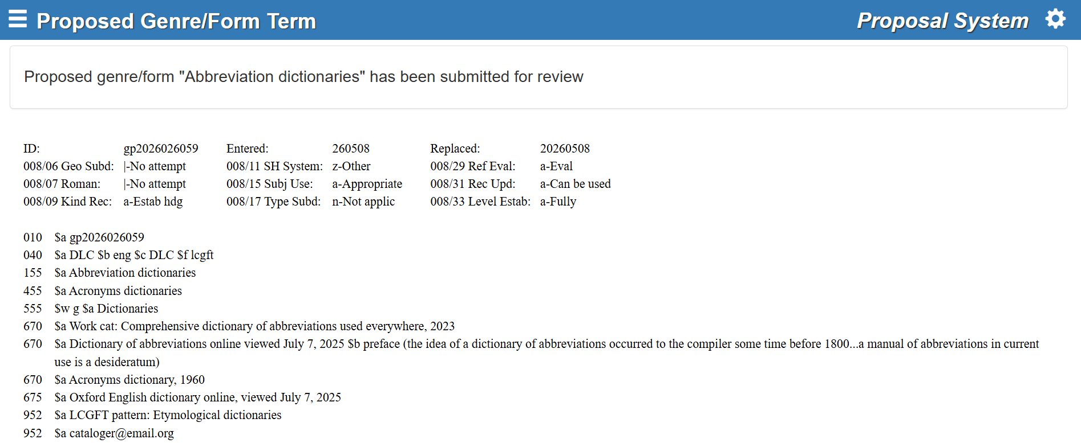
Image: ClassWeb Plus completed proposal form

Slide 34
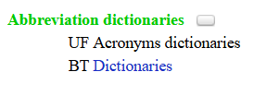
New proposal
Image: Display of Abbreviation dictionaries in green font in ClassWeb plus

Slide 35
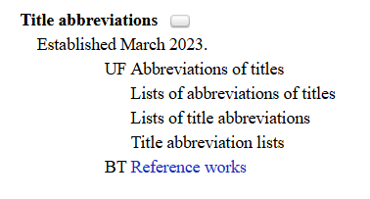
J 188: Related terms
“Related term references may be made if the terms have meanings that overlap to some extent, and/or if terms are used somewhat interchangeably.”
Image: Display of Title abbreviations in ClassWeb Plus

Slide 36
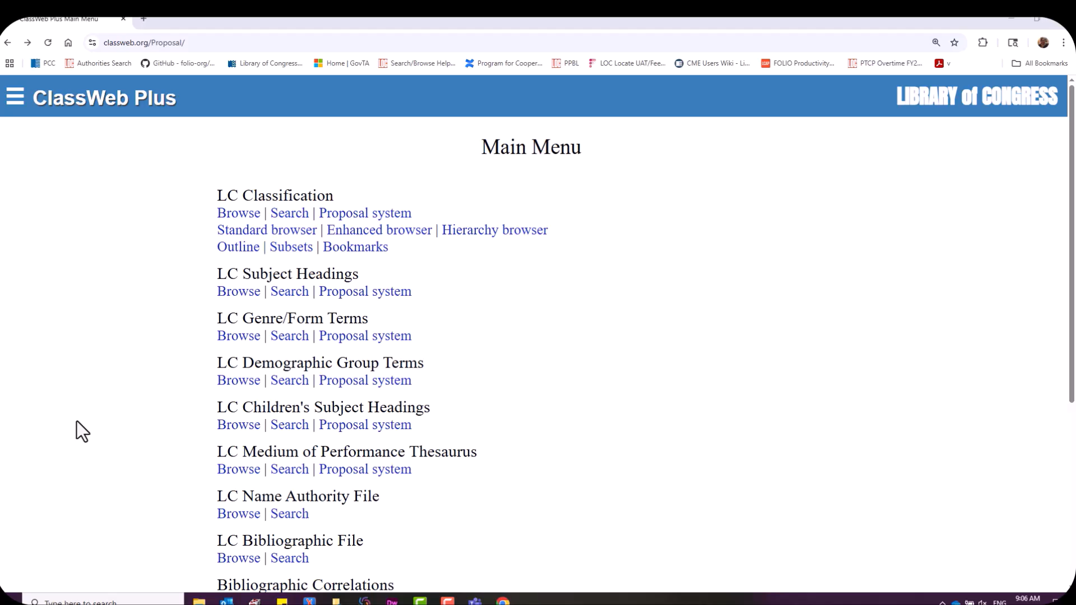

Slide 37
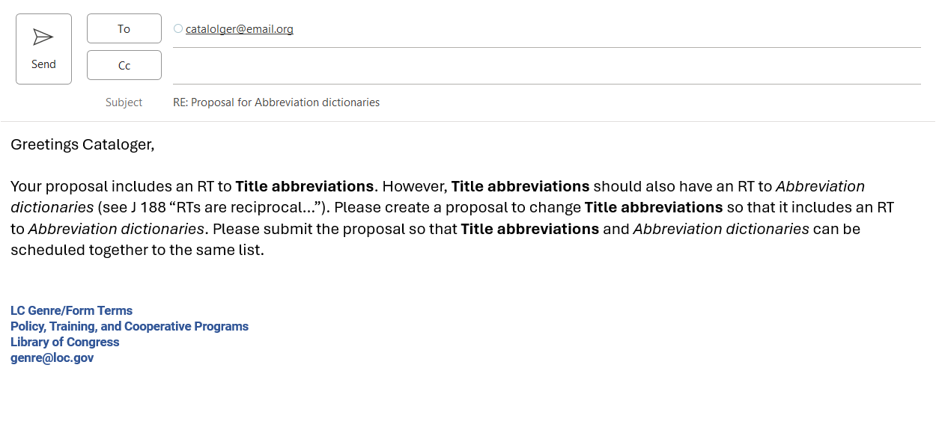
Follow up from the Library of Congress
Image: Email from LC

Slide 38
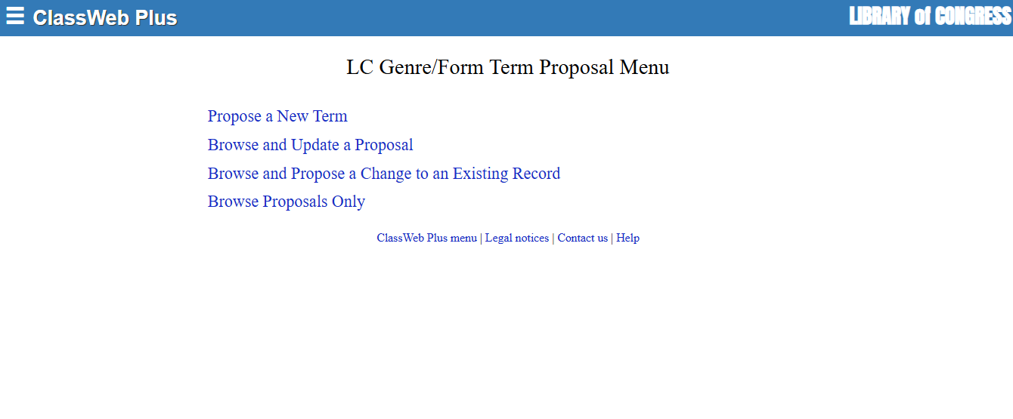


Slide 39
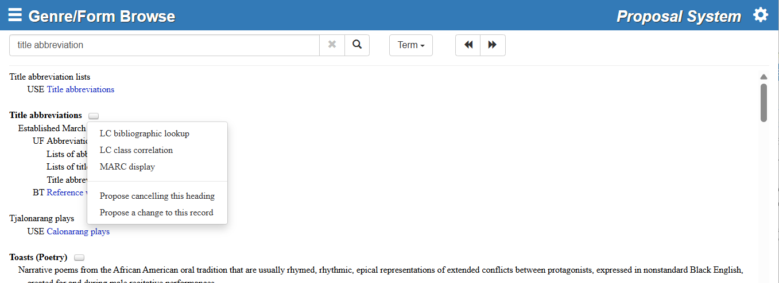


Slide 40
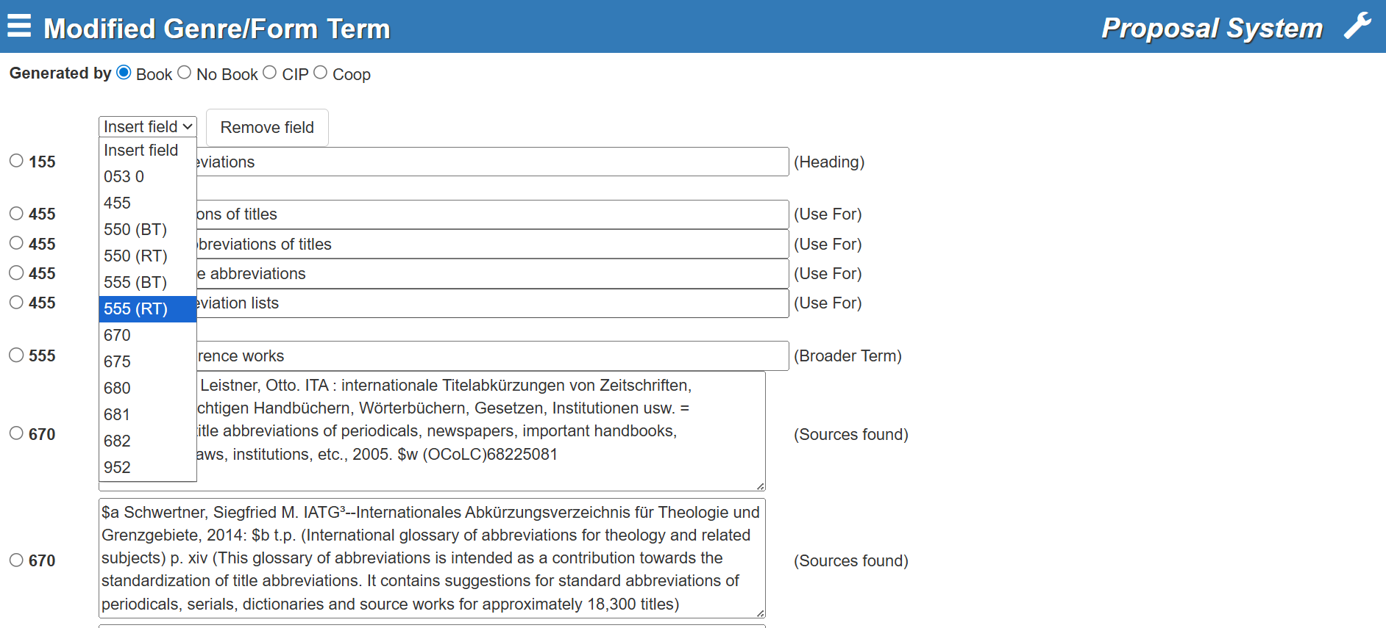

Slide 41
What’s next?
The Internal Review Process

Slide 42
End of Proposal Process. Part 2
genreform@loc.gov

