Slide 1
METS 1.x Data Model
Derived Implicitly from the XML Schema

Slide 2
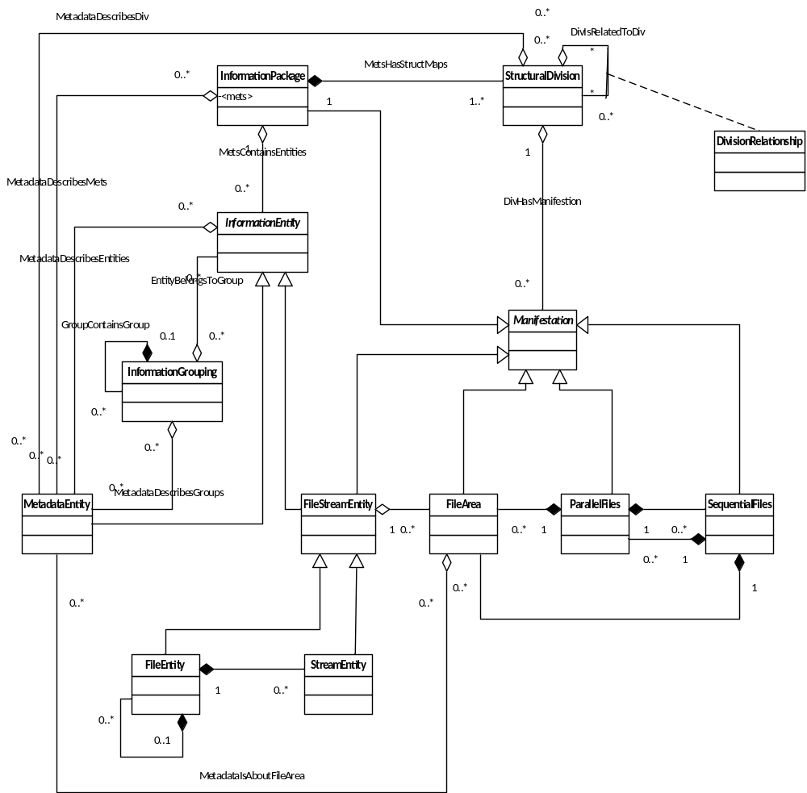
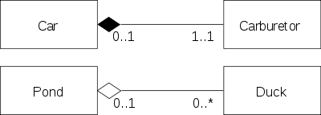
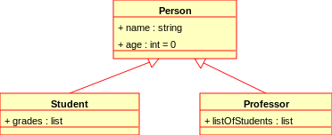
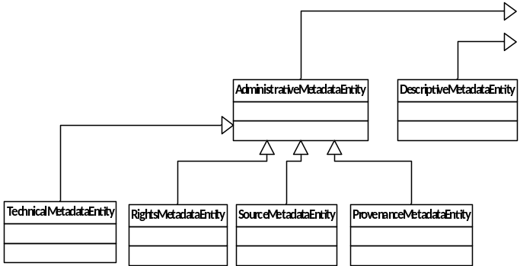
Abstract data model based the
current METS XML schema
UML Class Diagram
  Aggregation and Composition
  Generalization

Slide 3
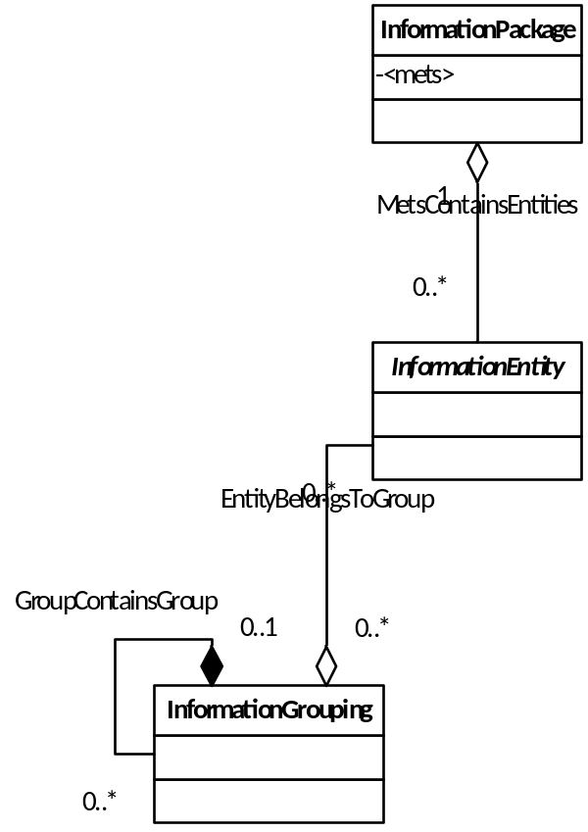
InformationPackage
  <mets>
    <metsHdr>
InformationEntity
  Content
    <binData>
    <xmlData>
  Pointer to content
    <mdRef>
    <Flocat>
  <stream>
  <transformFile>
InformationGrouping
  Common @GROUPID
  Nesting
    <fileGrp>
      <fileGrp>
      <file>
    <amdSec>
      <techMD>
      <rightsMD>
      <sourceMD>
      <digiprovMD>

Slide 4
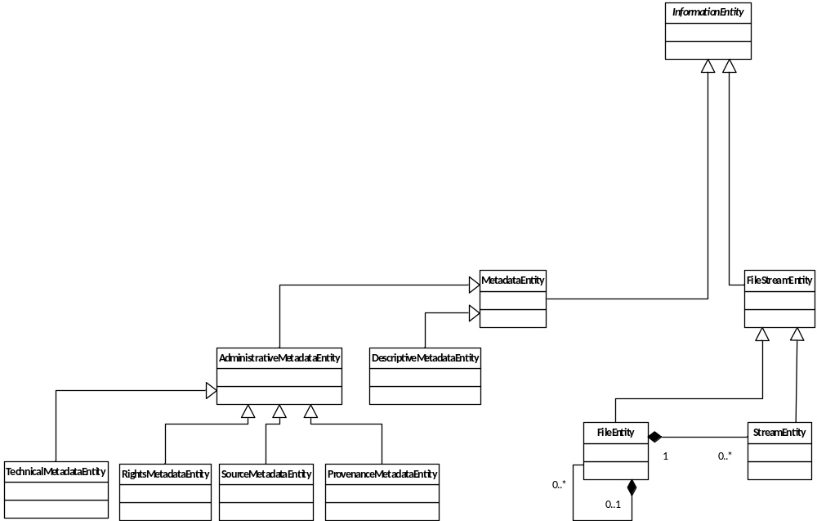
InformationEntity
  MetadataEntity
    <dmdSec>
    <amdSec>
      <techMD>
      <rightsMD>
      <sourceMD>
      <digiprovMD>
  FileStreamEntity
    <file>
      <file>
      <stream>

Slide 5
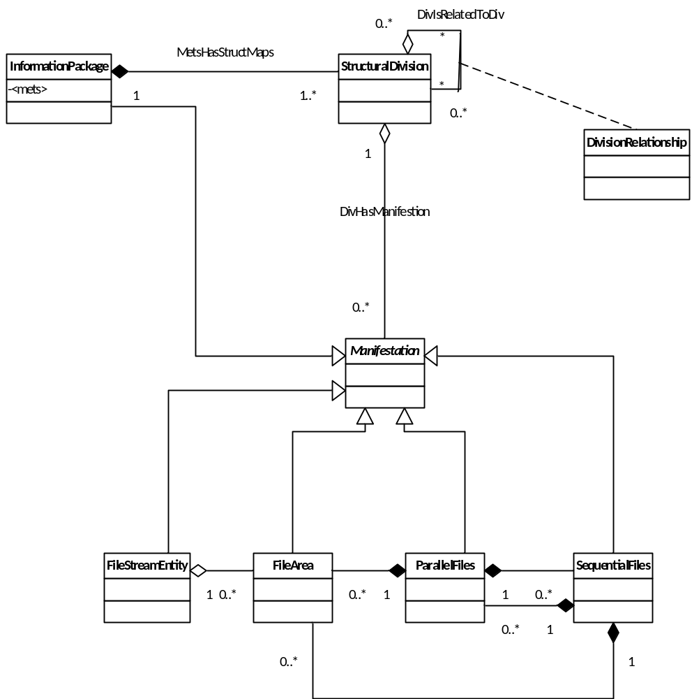
StructuralDivision
  <structMap>
  root <div>
DivisionRelationships
  Hierarchy
    <div>
      <div>
  Directed Graph
    @xlink:label
    <structLink>
  @LABEL
  @ORDER
  @ORDERLABEL
  @TYPE
  …
Manifestation (abstract)
  <div>
    <mptr>
    <fptr>
    <fptr>
      <par>
      <seq>
      <area>

Slide 6
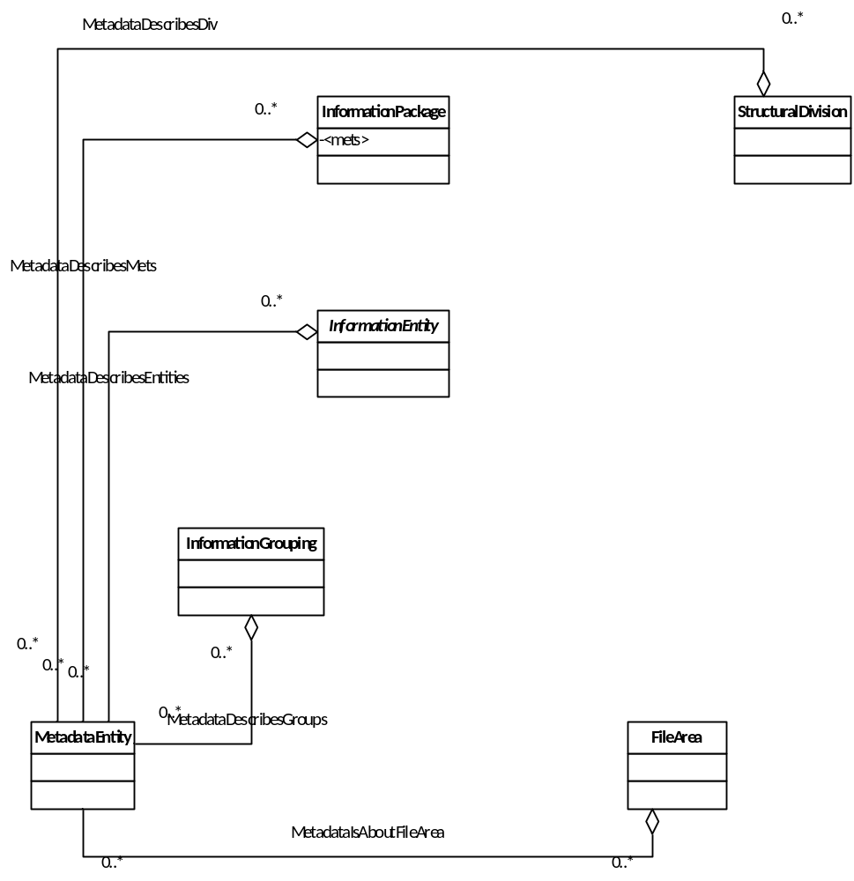
MetadataDescribes…
  InformationPackage
    <metsHdr> @ADMID
  StructuralDivision
    <div> @DMDID
    <div> @ADMID
  FileArea
    <area> @ADMID
  InformationGrouping
    <fileGrp> @ADMID
  InformationEntity
    <dmdSec> @ADMID
    <techMD> @ADMID
    <sourceMD> @ADMID
    <rightsMD> @ADMID
    <digiprovMD> @ADMID
    <file> @DMDID
    <file> @ADMID

Slide 7
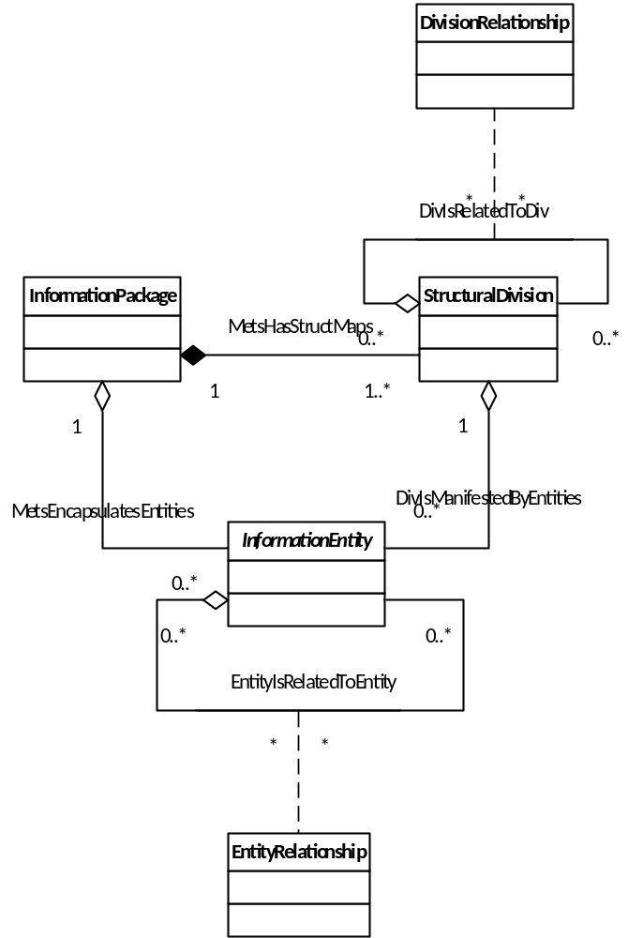
Preview of possible METS 2 Model

